Slide 1

Phase 2- Final Presentation
Prediction of CGPA using ML.
Group ID-G49
By:
UTKARSH VERMA 180178008
PRATICHI PAINULY 180178009
CHETNA GARG 180178010
KARTIK KUMAR 180178014

Slide 2

INTRODUCTION TO OUR PROJECT
Prediction of students’ CGPA using Machine Learning
The main objective of our project is to predict CGPA of students using Machine Learning and Deep Learning techniques with the help of some attributes present in our dataset (Quiz marks, attendance, IQ Score etc.).
APPLICATION:
To monitor the students’ academic performance
Early prediction of the final CGPA help the teachers to identify the students at risk and give high confidence in their studies

Slide 3




TOOLS AND TECHNOLOGIES USED
MACHINE LEARNING :
It's the study of computer algorithms that improve automatically through experience. It is seen as a subset of artificial intelligence.
TOOLS:
Anaconda Navigator
Jupyter Notebook
Spyder Notebook

Slide 4
SUMMARY OF LITERATURE STUDY
S No. | AUTHORS | OBJECTIVE | ATTRIBUTES | CONCLUSION
1. | Sandeep S. Ganorkar, Nandita Tiwari, Varsha Namdeo (2020) | Analysis and Prediction of Student Data using Data Mining Techniques like Association, Classification, Clustering Outlier Detection | Student ID, Gender, Date of birth, Place of birth, Speciality, Enrolment_year, Graduation_yea, City, Location, Address, Telephone, Matriculation, Secondary, school_type, Matriculation_year, College_GPA, Grade | Could not measure the accuracy because this paper is a review paper of data mining techniques.
2. | Nguyen Thai Nghe, Paul Janecek & Peter Haddawy (2020) | A Comparative Analysis of Techniques for Predicting Academic Performance (Data Mining Techniques, Decision Tree, Bayesian Network) | In total, 36 attributes were taken including CGPA, Field of Study, Age, Gender, Faculty, Religion, Country, Institute Rank. | Overall Accuracy was 86%(CTU) & 74%(AIT)
3. | SF Shetu, M Saifuzzaman NN Moon, S Sultana R Yousuf (2019) | Students performance prediction using Data Mining techniques depending on overall academic status & environmental attributes | Attributes having categorical variables (high avg. low): CGPA, gender, attendance, class test, drug addiction, social media, attention, depression & extra-curricular | Correctly classified instances 77.4319% Incorrectly classified 22.5681% Mean absolute error 0.1087

Slide 5
4. | E.T. Lau, L. Sun, Q Yang (2019) | Modelling prediction and classification of student academic performance using ANN | National university entrance exam result and socio- economic background of the students along with previous attained CGPA taking in consideration their credit hours. | Accuracy: 84.8% Error: 15.02% Precision: 86.3% Area under curve: 0.86 which proves to be a good result
5. | Md. R Islam Rifat AA Imran A.S.M Badrudduzza (2019) | A deep neural network approach for predicting CGPA of undergraduate students | Student name, ID, Gender SGPA, Course Grade | Accuracy was compared on the bases of baseline model: decision tree. Mean sq. error (decision tree: 0.0226, Deep neural network: 0.008)
6. | Vaibhav Kumar, ML Garg (2018) | Comparison of Machine Learning model in Student Result prediction | Schooling Marks, Continuous Assessment, Final Evaluation | Highest Accuracy achieved by Gradient Boost model-98.26% Neural Network – 97.05%
7. | Priyanka Dhamija, R Nandal H Sehrawat (2017) | A review paper on prediction analysis: predicting student’s result on the bases of past results | Class behaviour, Exam result, class attendance, extra-curricular | In WEKA tool the past result is given as the input & using appropriate algo a predictive model is generated. By this institutes can classify which students need attention or have low predicting grades.

Slide 6
8. | Pushpa S K, Manjunath T N, Mrunal T V, Amartya Singh, P Suhas (2017) | Class Result prediction using ML using Support Vector Machine, Naïve Bayes’, Random Forest, Gradient Boosting | Internal Score, external score, and total score | SVM- 87.5% Naïve Bayes’ – 87.5% Random forest- 89% Gradient Boosting-82%
9. | Mukesh Kumar AJ Singh Disha Handa (2017) | Literature survey on students’ performance prediction in education using data mining techniques | Personal, family, institutional and social attributes | k-nearest neighbours and Naïve Bayes’ proved to be best.
10. | Md. Fahim Sikder Md. Jamal Uddin & Sajal Halder (2016) | Predicting students’ yearly performance using Neural Network | In total 14 attributes were taken including test marks, attendance, Lab performance, Previous result, Social media interaction, Study Time | Best Accuracy-88% Average- 74% Neural network proved out to be the best method when compared with other ML models by having least error.
11. | Radhika R Halde, Arti Deshpande & Anjali Mahajan (2016) | Psychology assisted Prediction of Academic Performance using Machine Learning | Pre-university percentage, Matric percentage, Semester CGPA, Motivation, Concentration, Management, Study Aids, Study Main Ideas | Accuracy without Psychological Factors=0.9310 Accuracy with Psychological Factors=0.9999
12. | S Sebastian JJ Puthiyidan (2015) | Evaluating students’ performance by artificial neural network using WEKA | Related to academic details (Interest of study, unit-test marks, attendance, assignment) & personal attributes (Residence, parent education, family status). | K fold cross validation: 91% Association rule mining: 62%

Slide 7
13. | Jamalul-lail Ab Manan, Pauziah Mohd Arsad, Norlida Buniyamin (2014) | Neural Network and Linear Regression Methods for Prediction of Students’ Academic Achievement | CGPA is the only parameter measured of the students of Electrical Engineering. | Both prediction models indicated similar results as far as Mean Square Error is concerned.
14. | Dorina Kabakchieva (2013) | Predicting Student Performance by Using Data Mining Methods for Classification | Age, Gender, Ethnicity, Education, Work Status & Disability | Accuracy with Decision tree = 66% k-Nearest = 60%
15. | R.R. Kabra, R.S. Bichkar (2011) | Performance Prediction of Engineering Students using Decision Trees | Branch, HSC Percent, SSC Percent, SSC Maths, SSC Science, Category, Gender, Living Location, SSC Board, Father_occupation, Mother_occupation | The accuracy of the model is 60.46 %. That is out of 346 instances 209 instances are correctly classified.
16. | Zaidah Ibrahim Daliela Rusli (2007) | Predicting students’ academic performance: Comparing ANN, Decision tree and Regression | IT application knowledge, Previous schooling, Programming knowledge, Family financial status, CGPA | Evaluation was done on RASE (sq. Root of Average Squared Error) ANN has lowest RASE: 0.1714 Decision tree: 0.1769 Regression: 0.1848

Slide 8
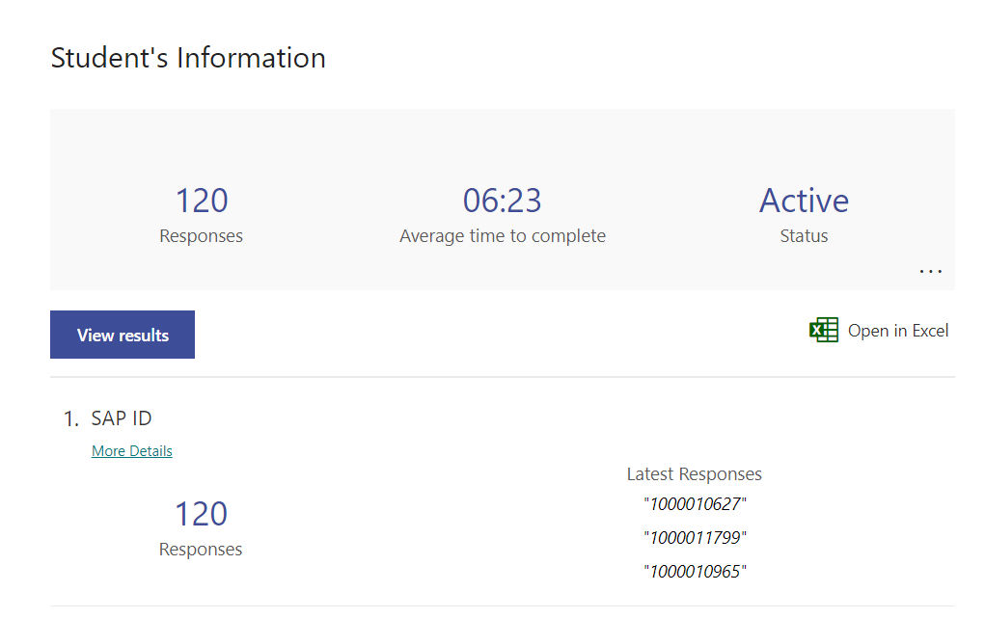
Slide 3
OUR DATASET
It will contain the attributes required to calculate the result CGPA of the students. Here we are using both academic and social attributes affecting student’s life.
Here, we will take the dataset of our batch students at the University.
The attributes include:
[1] Programming knowledge
[2] Daily social media interaction
[3] Physical activity
[4] Attendance
[5] Self study duration
[6] External study references
[7] Attention during classes
[8] Frequency of doubt-clearing during group study
[9] SGPA of previous semesters
(Link for the survey form: https://forms.office.com/r/tLk27FhyVw)
(Link for the dataset: https://bit.ly/2PXvv1c)

Slide 9

DATASET PRE-PROCESSING
Acquire the dataset
Import all the crucial libraries (Numpy, Pandas, Matplotlib)
Import the dataset
Identifying and handling the missing values
Encoding the categorical data
Splitting the dataset (Training and Testing sets)
Feature Scaling

Slide 10
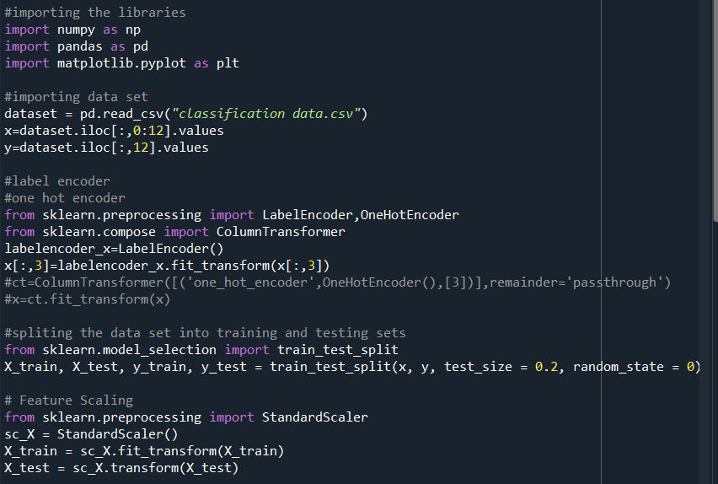
PRE – PROCESSING STEPS

Slide 11


MACHINE LEARNING MODELS APPLIED IN PHASE – 2
REGRESSION MODELS:
Multiple Linear Regression
Random Forest Regression
CLASSIFICATION MODELS:
Random Forest Classification
Decision Tree Classification
Naïve Bayes’ Classification
Logistic Regression Classification

Slide 12
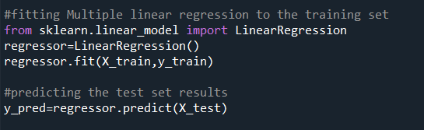
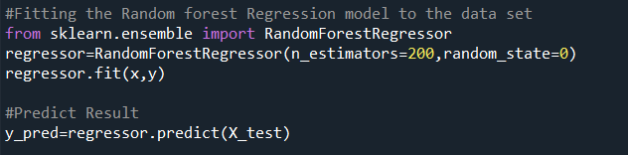
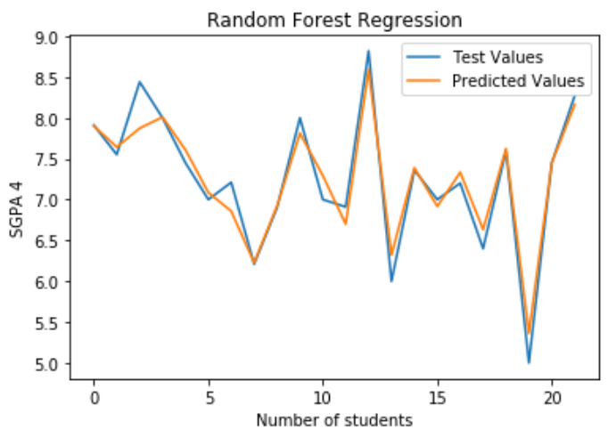
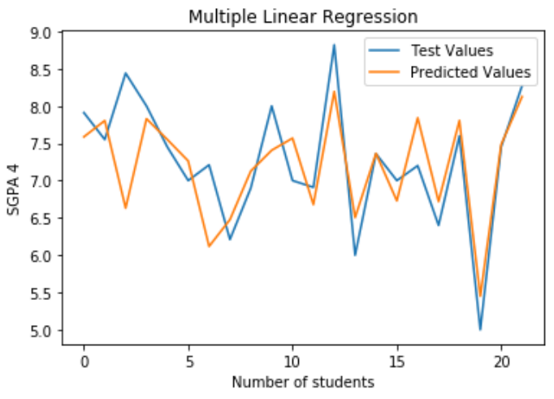
MULTIPLE LINEAR REGRESSION
RANDOM FOREST REGRESSION

Slide 13

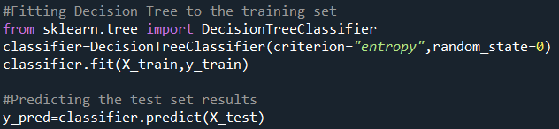
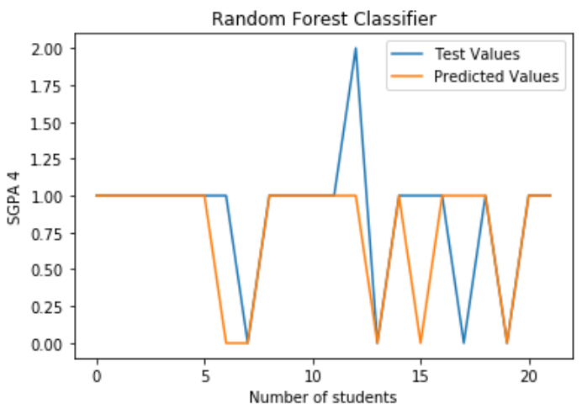
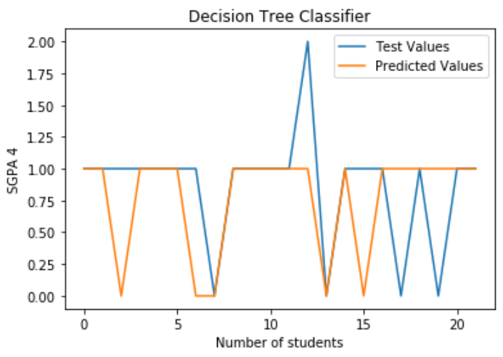
RANDOM FOREST CLASSIFICATION
DECISION TREE CLASSIFICATION

Slide 14
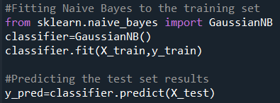
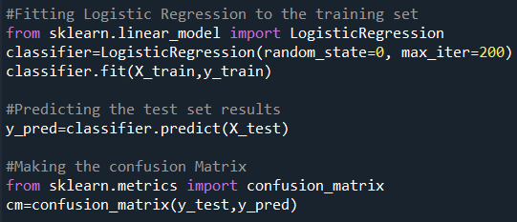
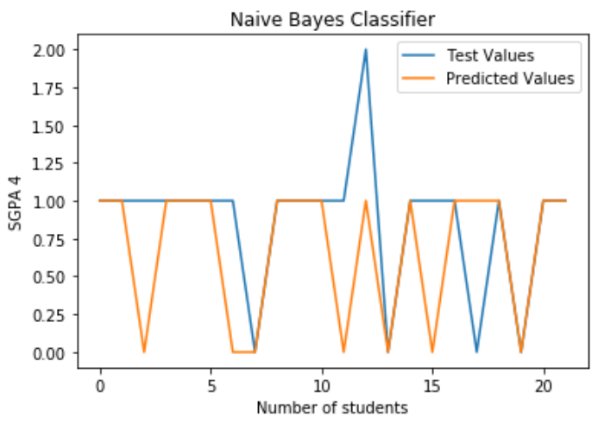
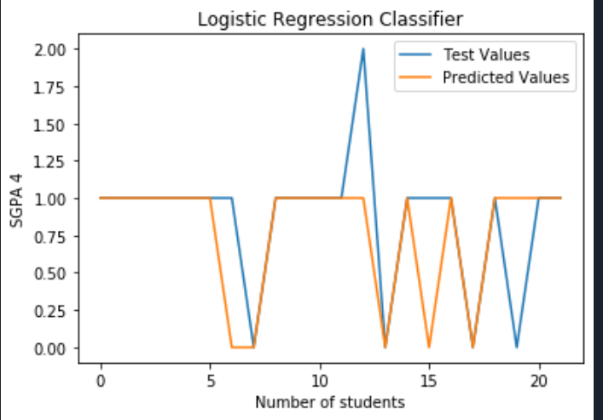
NAÏVE BAYES’ CLASSIFICATION
LOGISTIC REGRESSION CLASSIFICATION

Slide 15
RESULT SUMMARIZATION
S No. | Name of the model | MAE | MSE | RMSE | Train Score | Test Score
1. | Multiple Linear Regression | 0.39 | 0.30 | 0.55 | 0.79 | 0.51
2. | Random Forest Regression | 0.16 | 0.046 | 0.21 | 0.97 | 0.93
3. | Random Forest Classification | 0.18 | 0.18 | 0.42 | 1.0 | 0.81
4. | Logistic Regression | 0.18 | 0.18 | 0.42 | 0.97 | 0.81
5. | Decision Tree Classification | 0.27 | 0.27 | 0.52 | 1.0 | 0.73
6. | Naïve Bayes’ Classification | 0.28 | 0.27 | 0.50 | 0.92 | 0.72

Slide 16
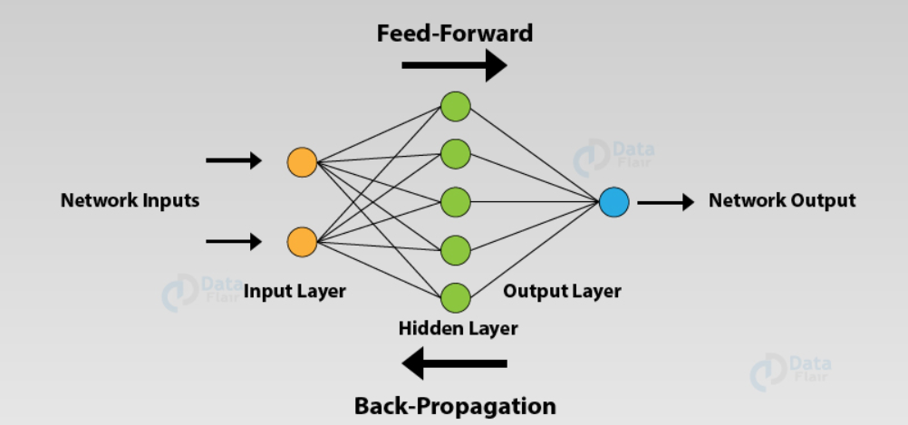
ROAD MAP TO PHASE 3: ARTIFICIAL NEURAL NETWORK
An Artificial Neural Network (ANN) is the component of artificial intelligence that is meant to simulate the functioning of a human brain. Neurons which are the processing units make up ANN’s and they consist of inputs and outputs.

Slide 17
THANK YOU
TEAM MEMBERS:
UTKARSH VERMA 180178008
PRATICHI PAINULY 180178009
CHETNA GARG 180178010
KARTIK KUMAR 180178014

